Slide 1


Symfony
Open Source PHP Framework
Notes:
© SUPINFO International University - http://www.supinfo.com
SUPINFO vous permet de partager ce document
Vous êtes libre de :
Partager — reproduire, distribuer et communiquer ce document Remixer — modifier ce document
A condition de respecter les règles suivantes :
Indication obligatoire de la paternité — Vous devez obligatoirement préciser l’origine « SUPINFO » du document au début de celui-ci de la même manière qu’indiqué par SUPINFO International University – Notamment en laissant obligatoirement la première et la dernière page du document, mais pas d'une manière qui suggérerait que SUPINFO International University vous soutiennent ou approuvent votre utilisation du document, surtout si vous le modifiez. Dans ce dernier cas, il vous faudra obligatoirement supprimer le texte « SUPINFO Official Document » en tête de page et préciser notamment la page indiquant votre identité et les modifications principales apportées.
En dehors de ces dispositions, aucune autre modification de la première et de la dernière page du document n’est autorisée.
NOTE IMPORTANTE : Ce document est mis à disposition selon le contrat CC-BY-NC-SA Creative Commons disponible en ligne http://creativecommons.org/licenses ou par courrier postal à Creative Commons, 171 Second Street, Suite 300, San Francisco, California 94105, USA modifié en ce sens que la première et la dernière page du document ne peuvent être supprimées en cas de reproduction, distribution, communication ou modification. Vous pouvez donc reproduire, remixer, arranger et adapter ce document à des fins non commerciales tant que vous respectez les règles de paternité et que les nouveaux documents sont protégés selon des termes identiques. Les autorisations au-delà du champ de cette licence peuvent être obtenues à support@supinfo.com.
© SUPINFO International University – EDUCINVEST - Rue Ducale, 29 - 1000 Brussels Belgium . www.supinfo.com

Slide 2

Course objectives
Symfony
By completing this course, you will be able to:
Describe the Symfony philosophy
Create a new Symfony app
Discover MVC pattern in Symfony
Debug your app with Symfony profiler
Manage security within Symfony

Slide 3


Course plan
Symfony
Overview
Installation
Symfony architecture
MVC Pattern in Symfony
Request, Routes & Bundle
FOSUserBundle

Slide 4

overview
Symfony

Slide 5

What is a framework?
Framework overview
A reusable set of libraries or classes for a software system
Allows developers to create complex applications with minimal effort

Slide 6
What is a framework?
Framework overview
A framework consists of:
A toolbox:
A set of components used to help you at each development step
Write less code with less risk of error
A methodology:
A specific request/response pattern (for example MVC)
Guarantees the stability, maintainability and upgradeability of the applications you develop

Slide 7
What is a framework?
Framework overview
There is many frameworks related to PHP:
Zend Framework
CodeIgniter
CakePHP
And Symfony!
Notes:
http://fr.wikipedia.org/wiki/Liste_de_frameworks_PHP

Slide 8
Quick start
What is Symfony?
A French Open Source Framework in PHP 5.3
Supported by
A set of standalone PHP components bundled together
Complete rewrite of Symfony 1.x :
Less concepts
More Flexible
Faster

Slide 9
Quick start
What is Symfony?
Sf2 follows standards and best practices:
Design Pattern
MVC
Dependency injection
RFC 2616 (HTTP)
PHPUnit
Jinja Templates
Notes:
RFC2616: HTTP protocol
Follows standards to be fully testable with PHPUnit
Respect python templates called Jinja Template

Slide 10
Built-in components
What is Symfony?
Built on the shoulders of giants :
Twig
Swiftmailer
Doctrine 2
The first two are provided by

Slide 11


Questions ?

Slide 12
INstallation
Symfony

Slide 13
Download and Unpack
Installation
To use Symfony, follow these steps:
Download Symfony3 at the following URL:
http://symfony.com/download
Follow instructions
Check it works by visiting:
http://localhost:8000/
Notes:
Be careful: Take care of permissions on /app/cache & /app/log

Slide 14

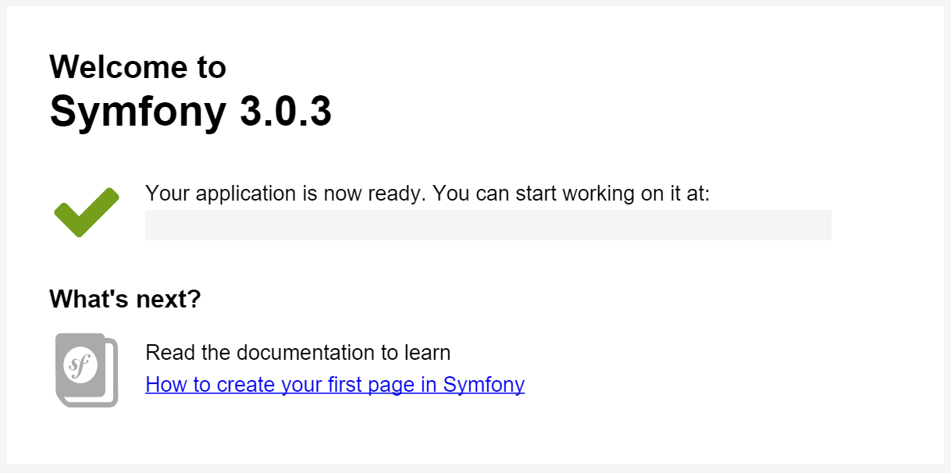
You should see…
Installation

Slide 15
Virtual Host
Installation
The URL is not pretty, so we have to create a Virtual Host.
Edit the file httpd.conf located in « conf » folder of the Apache directory.
At the end, we paste the following code:
Notes:
http://en.wikipedia.org/wiki/Virtual_hosting

Slide 16
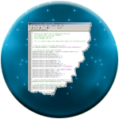
Virtual Host inside httpd.conf
Installation
Link http://symple.net to your Sf2 install:
# httpd.conf or vhosts.conf
<VirtualHost 127.0.0.1>
ServerName symple.net
DocumentRoot "C:\path\to\www\folder\symple\web"
DirectoryIndex app.php
<Directory "C:\path\to\www\folder\symple\web">
AllowOverride All
Allow from All
</Directory>
</VirtualHost>
Notes:
If you already have a virtual host on your xAMP installation, use this tutorial [FR] : http://www.pixme.fr/blog-art-19-Wampserver-Simuler-un-nom-de-domaine.html

Slide 17
Virtual Host and hosts file
Installation
Link http://symple.net to your Sf2 install:
Hosts file on each platform:
Windows: \Windows\System32\drivers\etc\hosts
Mac: /private/etc/hosts
Linux: /etc/hosts
# hosts file on your computer
symple.net 127.0.0.1

Slide 18
Done!
Installation
Restart Apache.
Now everything shoud be working.
Check: http://symple.net/

Slide 19
Questions ?

Slide 20

Exercise (1/2)
Installation
Extract latest version into a folder named symple.net, inside your www directory
Check your install :
http://localhost:8000
Define a Virtual Host

Slide 21
Exercise (2/2)
Installation
Check your install by clicking on:
http://symple.net/
Create a new MySQL database
Browse into http://localhost/phpmyadmin
Create a database called symple

Slide 22

Symfony Architecture
Symfony

Slide 23

Quotation
Symfony Architecture
“Symfony is an HTTP Framework”
– Fabien Potencier Founder of Sensio Labs Symfony lead developer

Slide 24
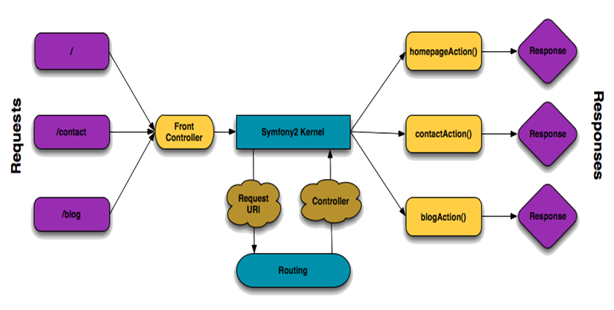
Schema
Symfony Architecture
Source : http://symfony.com/doc/current/book/routing.html
Notes:
From left to right :
Purple cells next to « Requests » symbolizes URLs entered by the client
All these requests goes to the front Controller, who forward information to Symfony Kernel.
This kernel calls the right controller for the client’s request thanks to the routing engine.
He next calls the right function in the controller, who sends back the response.

Slide 25
Schema
Symfony Architecture
Source : http://symfony.com/doc/current/book/routing.html
Notes:
http://code.anonymation.com/symfony-2/le-mvc-dans-symfony-2-cheminement-dune-requete-http/ http://docs.symfony-reloaded.org/master/book/http_fundamentals.html

Slide 26
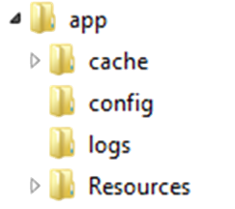
Directory structure
Symfony Architecture
App: Configuration and other resources
…………………………Caching files generated by Symfony
…………………………………………………….Configuration files
……………………………………………………………………….Log files
…………………………………………I18n, template view, …

Slide 27


Directory structure
Symfony Architecture
Bin: Script to auto update bundle and Sf2 libs
Vendor: Contains all third-party libraries (Twig, Doctrine, Swiftmailer, …)

Slide 28


Directory structure
Symfony Architecture
Src: Contains all your PHP code, with your bundles, your templates, your functions
Web: Home of static files (like css, js, etc)

Slide 29


Profiler – Powerful debug tool
Symfony Architecture
View app in development mode:
http://symple.net/app_dev.php/test
Show errors info, stack trace and Symfony toolbar
View app in production mode:
http://symple.net/test
For security reasons, no info are given to visitors

Slide 30
Questions ?

Slide 31

Controller Layer
Symfony
Enhancing PHP with Symfony layer

Slide 32
Presentation
Controller layer
The controller process the logic layer
Contains all PHP code related to data treatment
In Symfony, you can define your own controllers
Extends the Controller class
Stored in: src/{NameSpace}/{Bundle}/Controllers

Slide 33
Default controller example
Controller layer
A default controller look like this:
class DefaultController extends Controller {
/**
* @Route("/hello/{name}")
*/
public function indexAction($name) {
var_dump($name);
}
}

Slide 34
@Route
Controller layer
The @Route annotation specify which URL is related to this function
Keys in braces means variables
You’ll know more about Routes further in this course

Slide 35
Rendering a template
Controller layer
Redirect data to a template file
Views are located in:
app/Resources/views or {bundle}/Resources/views
/**
* @Route("/hello/{name}")
**/
public function helloAction($name) {
return $this->render('default/hello.html.twig',
array('name' => $name)
);
}

Slide 36
Actions
Controller layer
Can return different things, mostly an array
Each action must return something
Return a value from the controller to the view:
return $this->render('default/hello.html.twig',
array(
'name' => $name,
'otherValue' => 1,
'thirdValue' => "Plop"
)
);

Slide 37
Redirecting an user
Controller layer
Two ways:
By hardcoding URL:
By generating URL with a route name:
We’ll see it later
return $this->redirect("http://www.google.fr");
return $this->redirectToRoute('homepage');

Slide 38
Questions ?

Slide 39

View Layer
Symfony
The almighty Twig!

Slide 40
Presentation
View layer
Views represents the User Interface
Stored in Resouces/views
One folder by Controller
Contains HTML structure
Can use Twig template engine!

Slide 41
Twig presentation
View layer
Twig is a PHP template engine integrated in Sf2
Simple and readable syntax
Same functionnalities as PHP
Official documentation:
http://twig.sensiolabs.org/documentation

Slide 42
<!DOCTYPE html>
<html>
<head>
<title>Welcome to Symfony!</title>
<meta charset="UTF-8">
</head>
<body>
<h1><?php echo $page_title; ?></h1>
<ul id="navigation">
<?php foreach($navigation as $item): ?>
<li>
<a href="<?php echo $item->getHref(); ?>">
<?php echo $item->getCaption(); ?>
</a>
</li>
<?php endforeach; ?>
</ul>
</body>
</html>
Without Twig – Example

Slide 43
<!DOCTYPE html>
<html>
<head>
<title>Welcome to Symfony!</title>
<meta charset="UTF-8">
</head>
<body>
<h1>{{ page_title }}</h1>
<ul id="navigation">
{% for item in navigation %}
<li>
<a href="{{ item.href }}">
{{ item.caption }}
</a>
</li>
{% endfor %}
</ul>
</body>
</html>
With Twig – Example

Slide 44
Syntax
View layer
Three main types of tags:
{{ myVar }}
Displays a value, a function result
{% for cell in array %}
Execute a function or call Twig keywords
{# This is a comment #}
Comments

Slide 45
Variables management
View layer
From where come variables?
Controllers!
The « return » statement from controller passes values to the view
You can also pass objects

Slide 46
Controller / View interaction
View layer
Controller function:
View (Twig) code:
public function indexAction($firstname, $lastname) {
return array('name' => $firstname . " " . $lastname);
}
...
<span>Hello {{ name }}!</span>
...

Slide 47
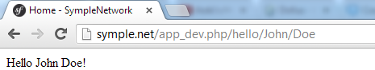
Browser rendering
View layer
Result:

Slide 48

Twig tags
View layer
Twig has some useful tags, we’ll see:
For
Empty & Defined
Dump
Date
Import & Macro

Slide 49
For
View layer
Makes a « for » loop in view:
Iterates through an array
Example controller’s action:
public function indexAction() {
return array('array' =>
array("foo", "bar", "boom", "baz"));
}

Slide 50
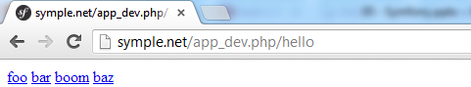
For
View layer
Use values in template:
Result:
{% for item in array %}
<a href="#">{{ item }}</a>
{% endfor %}

Slide 51
Empty and Defined
View layer
Empty: Checks if a variable is empty
Null, false, or an empty String
Defined: Checks if the variable is defined
{# Evaluates to true if the foo variable is null,
false, or an empty string #}
{% if foo is empty %}
{# Do something here #}
{% endif %}

Slide 52
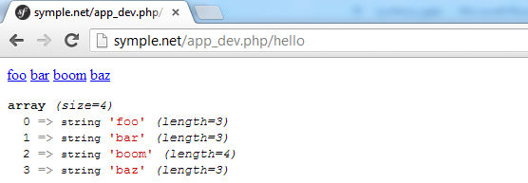
Dump
View layer
Dump: Calls PHP var_dump() function
Outputs the variable in HTML page
Result:
{{ dump(array) }}

Slide 53
Activate dump function for production
View layer
Dump needs a special configuration
Prevents dump output in a production environment
To use it, define this in config.yml:
services:
symplenetwork:
class: Twig_Extension_Debug
tags:
- { name: 'twig.extension' }

Slide 54
Date
View layer
Date: Special filter used as a converter
Formats DateTime() objects into String
Example controller’s action:
public function helloAction() {
return $this->render(...,
array("myDate" => new \DateTime())
);
}
Notes:
Note: You have to use \ before DateTime because the controller is actually in a namespace.
If you forget the backslash, PHP searches for the class DateTime in current namespace, SympleNetwork\UserBundle\Controller.

Slide 55
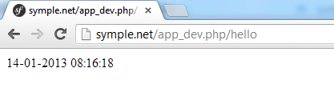
Date
View layer
Date:
Shows date in template:
Result:
{{ myDate|date("d-m-Y h:i:s") }}

Slide 56
Macro
View layer
Define functions in a helper module file
File called for example « functions.html.twig »
Call it in your template:
{% macro funcName(args) %}
{# function definition #}
{% endmacro %}
{% import "::functions.html.twig" as funcs %}
{{ funcs.funcName("an argument") }}

Slide 57
Macro
View layer
Twig functions have a special behavior:
Arguments are always optionnal
You need to call default() function
Contains default value if argument is null or empty

Slide 58
Macro complete example
View layer
File functions.html.twig:
File index.html.twig:
{% macro input(type) %}
<input type="{{ type|default('text') }}" />
{% endmacro %}
{% import "::functions.html.twig" as funcs %}
{{ funcs.input() }}
{{ funcs.input("button") }}

Slide 59
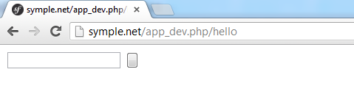
Browser rendering
View layer
Result:

Slide 60
Templating
View layer
In Twig you can also create view inheritance
Works with a « block » system
Piece of HTML code usable in children views
Defined with{% block %} tags
Easy to create template inheritance
Represented by {% extends %} tags

Slide 61
Templating
View layer
How it works?
Use a base template (your page design)
With header, content and footer
Contains some Twig blocks
Located in app/Resources/views/base.html.twig
Reference it in a child template (a single page)
An « index » page who extends the « base »
Override Twig blocks

Slide 62
Base template example
View layer
<!DOCTYPE html>
<html>
<head>
<title>{% block title %}{% endblock %}</title>
</head>
<body>
<div id="content">
{% block content %}{% endblock %}
</div>
<div id="footer">
{% block footer %}{% endblock %}
</div>
</body>
</html>

Slide 63
Child template example
View layer
{% extends "::base.html.twig" %}
{% block title %}Home - SympleNetwork{% endblock %}
{% block content %}
<span>Hello {{ name }}!</span>
{% endblock %}
{% block footer %}
<span>Copyright SympleNetwork&copy;</span>
{% endblock %}

Slide 64
Calling a parent block
View layer
When extending templates, you can also call content from parent block
Example code from base.html.twig:
<title>
{% block title %}- SympleNetwork{% endblock %}
</title>

Slide 65
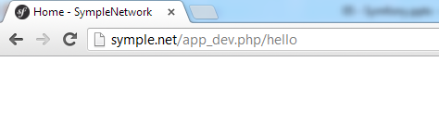
Calling a parent block
View layer
Example code in index.html.twig:
Result:
{% block title %}Home {{ parent() }}{% endblock %}

Slide 66
Symfony Cache System
View layer
Note that Symfony has a cache system
Only in production environment
http://symple.net/app_debug.php/thing is not cached
http://symple.net/thing is cached
Cache system is based on URLs
Returns previous generated page if URL is the same
Rendering optimization

Slide 67
Symfony Cache System
View layer
If everything works on app_dev.php and not in production environment, you can delete the cache folder
Use this command to do so:
php bin/console cache:clear -e prod --no-debug

Slide 68
Questions ?

Slide 69
Exercise (1/3)
Controller layer
Create your first bundle
Command: php bin/console generate:bundle
Namespace: SympleNetwork/UserBundle
Hit « Enter » key for other properties

Slide 70
Exercise (2/3)
Controller layer
Find the default controller
Change the route to /hello/{firstname}/{lastname}
Concat them in a $name variable
Dump Hello + $name + "!"
Your output should look like this:
Hello John Doe!

Slide 71
Exercise (3/3)
View layer
Refactor your controller to pass both firstname and lastname to the view
Use twig syntax to output them in index.html.twig
Locate base.html.twig
Add a simple HTML structure with some CSS

Slide 72

Model Layer
Symfony
Database interaction with Doctrine

Slide 73
Presentation
Model layer
Symfony has a built-in layer ORM
ORM : Object Relational Mapping
Called Doctrine
Access database in a simple way
Retrieve objects instead of array
Get rid of SQL language

Slide 74
Doctrine
Model layer
Doctrine is given with a DBAL
DataBase Abstraction Layer
Like PDO, but driver independant
Provides also more features
Manage the database as a set of PHP objects
Those objects are called Entities!

Slide 75
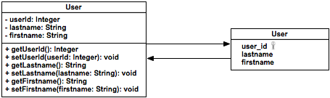
What is an entity?
Model layer
An entity class is composed of fields with getters and setters, embellished with some annotations

Slide 76
Symfony Database configuration
Model layer
Find in app/config a parameters.yml file
parameters:
database_host: 127.0.0.1
database_port: null
database_name: symple
database_user: root
database_password: null

Slide 77
Entity generation
Model layer
Entity generation process is in three steps
First, you need to generate metadatas relative to your database
php bin/console doctrine:mapping:import --force {Bundle} xml
Notes:
Note:
For better use, you should add the php executable in your « Path » environment variable
In this example, bin/console is a path, so you need to be in your root project directory (use cd command)
Absolute path command (for WAMP) :
"C:\wamp\bin\php\php5.3.9\php.exe" "C:\wamp\www\SympleProject\app\console" doctrine:generate:entities SympleNetworkUserBundle

Slide 78
Entity generation
Model layer
Next step, import these metadatas into Doctrine mapping engine
Generate your entities with this last command:
php bin/console doctrine:mapping:convert annotation ./src
php bin/console doctrine:generate:entities {Bundle}
Notes:
Note:
For better use, you should add the php executable in your « Path » environment variable
In this example, app/console is a path, so you need to be in your root project directory (use cd command)
Absolute path command (for WAMP) :
"C:\wamp\bin\php\php5.3.9\php.exe" "C:\wamp\www\SympleProject\app\console" doctrine:generate:entities SympleProjectUserBundle

Slide 79
Database generation
Model layer
At the opposite, you can create your own PHP entities and use following commands:
Generate database based on parameters.yml
Drop database if you want to update it
No need to tell you to be very careful with this command ☺
php bin/console doctrine:database:create
php bin/console doctrine:database:drop --force

Slide 80
Table generation
Model layer
At the opposite, you can create your own PHP entities and use following command:
It will create your tables !
But how to create your own entities ?
php bin/console doctrine:schema:update --force
Notes:
Note:
For better use, you should add the php executable in your « Path » environment variable
In this example, app/console is a path, so you need to be in your root project directory (use cd command)
Absolute path command (for WAMP) :
"C:\wamp\bin\php\php5.3.9\php.exe" "C:\wamp\www\SympleProject\app\console" doctrine:generate:entities SympleProjectUserBundle

Slide 81
Entity structure
Model layer
Doctrine use Java logic in several ways
Parameters for entity configuration are defined by annotations
In JavaDoc comments
/**
* @desc A JavaDoc description
*/

Slide 82
Entity declaration
Model layer
Look at the following entity declaration:
/**
* SympleNetwork\UserBundle\Entity\Post
*
* @ORM\Table(name="posts")
* @ORM\Entity
*/
class Post {
// ...
}

Slide 83
Entity declaration
Model layer
@ORM\Table
Specify table related to this entity
@ORM\Entity
Tells Symfony this class is an entity

Slide 84
Column declaration
Model layer
Look at the following column declaration:
/**
* @var integer $i
*
* @ORM\Column(name="id", type="integer", nullable=false)
* @ORM\Id
* @ORM\GeneratedValue(strategy="IDENTITY")
*/
private $id;

Slide 85
Entity declaration
Model layer
@ORM\Column
Name: Column name in database (String)
Type: Column type in database (String)
Nullable: Mandatory field or not (true|false)

Slide 86
Entity declaration
Model layer
@ORM\Id
Sets primary key
@ORM\GeneratedValue
Sets auto-increment

Slide 87
Foreign keys
Model layer
Doctrine manages your foreign key
You don’t have to add them in your entity
Define another entity as your property!
Embellished with annotations

Slide 88
Foreign keys - OneToOne
Model layer
Define a one to one relationship:
/**
* @OneToOne(targetEntity="Shipping")
*/
private $shipping;
Notes:
http://docs.doctrine-project.org/projects/doctrine-orm/en/2.0.x/reference/association-mapping.html

Slide 89
Foreign keys - OneToMany
Model layer
Define a one to many relationship:
In an Author entity:
/**
* @OneToMany(targetEntity="Post", mappedBy="Author",
* cascade={"persist"} )
*/
protected $posts;
Notes:
http://docs.doctrine-project.org/projects/doctrine-orm/en/latest/tutorials/in-ten-quick-steps.html

Slide 90
Foreign keys - ManyToOne
Model layer
Define a many to one relationship:
In a Post class:
/**
* @ManyToOne(targetEntity="Author")
*/
protected $author;
Notes:
http://docs.doctrine-project.org/projects/doctrine-orm/en/latest/tutorials/in-ten-quick-steps.html

Slide 91
Foreign keys - ManyToMany
Model layer
Define a many to many relationship:
/**
* @ManyToMany(targetEntity="Category")
*/
private $categories;
Notes:
http://docs.doctrine-project.org/projects/doctrine-orm/en/2.0.x/reference/association-mapping.html

Slide 92
Table generation
Model layer
No need to generate getters/setters
To make Doctrine write silly code:
Remove everything file in Resources/Config/doctrine folder
Call the following command:
Then update the database with:
php bin/console doctrine:generate:entities
php bin/console doctrine:schema:update --force
Notes:
You can check SQL requests that will be executed by typing this command (before the force):
php bin/console doctrine:schema:update --dump-sql

Slide 93
Doctrine CRUD
Model layer
CRUD stands for:
Create
Read
Update
Delete
Most of SQL queries running on a database

Slide 94
EntityManager
Model layer
Doctrine allows you to use an EntityManager
Manages CRUD operations
Define an EntityManager in your controller:
$em = $this->getDoctrine()->getManager();

Slide 95
EntityManager – Create
Model layer
persist($entity)
Allows to store an item in database
Works with flush() function
$em = $this->getDoctrine()->getManager();
$author = new User();
// Set values...
$em->persist($author);
$em->flush();

Slide 96
EntityManager – Read
Model layer
find($id)
Returns object corresponding to $id
$em = $this->getDoctrine()->getManager();
$author = $em->getRepository("SympleNetworkUserBundle:User")
->find(1);

Slide 97
EntityManager – Read
Model layer
findOneBy{Column}($val)
Returns one object based on column values
$em = $this->getDoctrine()->getManager();
$author = $em->getRepository("SympleNetworkUserBundle:User")
->findOneByName("John Cena");
$em = $this->getDoctrine()->getManager();
$author = $em->getRepository("SympleNetworkUserBundle:User")
->findOneBy(array(
"firstName" => "John",
"lastName" => "Doe"
));

Slide 98
EntityManager – Read
Model layer
findBy{Column}($val)
Returns many objects based on column values
$em = $this->getDoctrine()->getManager();
$authors = $em->getRepository("SympleNetworkUserBundle:User")
->findByName("John Cena");
$em = $this->getDoctrine()->getManager();
$authors = $em->getRepository("SympleNetworkUserBundle:User")
->findBy(array(
"firstName" => "John",
"lastName" => "Doe"
));

Slide 99
EntityManager – Read
Model layer
findAll()
Returns all objects
$em = $this->getDoctrine()->getManager();
$authors = $em->getRepository("SympleNetworkUserBundle:User")
->findAll();

Slide 100
EntityManager – Update
Model layer
Update
Get an entity by the find() function
Modify this entity
Flush Entity Manager
$em = $this->getDoctrine()->getManager();
$author = $em->getRepository("SympleNetworkUserBundle:User")
->find(1);
$author->setPassword("hi-there");
$em->flush();

Slide 101
EntityManager – Remove
Model layer
remove($entity)
Get an entity by the find() function
Remove it, then flush
$em = $this->getDoctrine()->getManager();
$$author = $em->getRepository("SympleNetworkUserBundle:User")
->find(1);
$em->remove($author);
$em->flush();

Slide 102
Questions ?

Slide 103
Exercise (1/5)
Model layer
Create the following table in your database:
Use Entities to Database or Database to Entities
At your convenience
post
id: Integer
message: Text
creationDate: DateTime

Slide 104
Exercise (2/5)
View layer
In your default controller:
Return an array containing:
An array of sample Post objects with the key « posts »
A firstname passed in URL as before
A lastname passed is URL as before

Slide 105
Exercise (3/5)
View layer
Create a Twig template wall.html.twig
Extending base.html.twig
Shows on top the firstname and lastname
All posts defined in controller
Put in it a form with:
A textarea
A button with a « Submit » text inside
The form is not supposed to work now

Slide 106
Exercise (4/5)
View layer
Create a file main.css in your « web » folder
Link to « /main.css » in your base.html.twig
Make your page pretty ☺

Slide 107
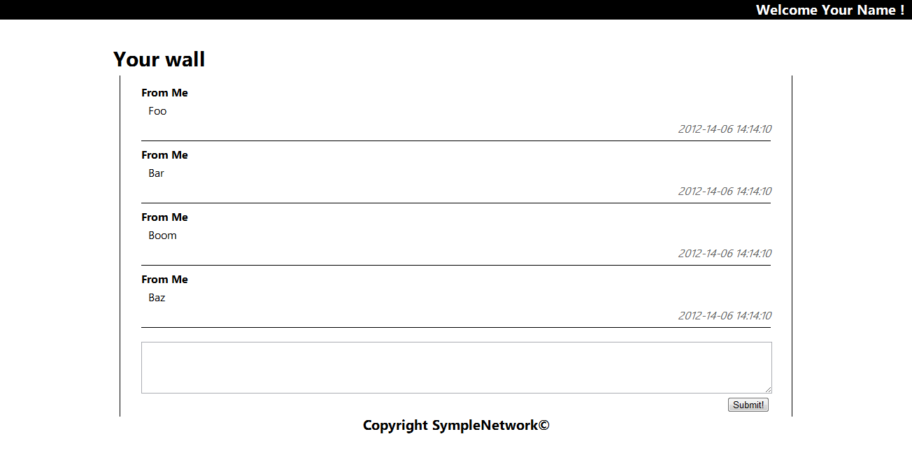
Exercise (5/5)
View layer

Slide 108
Request Context
Symfony

Slide 109
Introduction
Request context
In PHP, you can access user’s request variables in different arrays
$_GET
$_POST
And access user’s session with $_SESSION array

Slide 110
Introduction
Request context
In Symfony, you can access these values by getting the request context
Function $this->query
Function $this->request
In DefaultController.php:
$name = $this->query->get('name'); // $_GET['name']

Slide 111
Accessing GET values
Request context
Object query
Contains a ParameterBag object containing all GET parameters
Get « name » value passed with GET method:
$this->query->get("name");

Slide 112
Accessing POST values
Request context
Object request
Contains a ParameterBag object containing all POST values
Get « name » value passed with POST method:
$this->request->get("name");

Slide 113
Accessing SESSION values
Request context
Function getSession()
Returns a Session object containing all SESSION values
Get « name » value stored in session:
$session = new Session();
$session->get("name");

Slide 114
Checking request method
Request context
Some pages won’t process the same code depending on the request method
If the user displays the page, you need to show it up
But if he submits a form, you need to handle datas
Symfony has also a special function to do that!

Slide 115
Checking request method
Request context
Checking HTTP verb:
Also possible in method annotations
$this->getMethod() == "POST") {
// Process form validation
}
// Display page
/**
* @Method("POST")
**/

Slide 116

Add a flash in your page
Request context
A flash is a little explanation displayed to user
Confirm a successful submit
Show errors
Warn about something
…
Symfony allows you to define a flash text easily

Slide 117
Checking request method
Request context
Define a flash:
Get flashes in a twig template:
$this->addFlash("key", "Some flash text!");
{% for flash_message in app.session.flashbag.get('key') %}
<div class="flash-notice">
{{ flash_message }}
</div>
{% endfor %}

Slide 118
Questions ?

Slide 119

Routing Concept
Symfony

Slide 120
Overview
Routing concept
You use from the beginning URLs that are rewritten by Symfony engine. Example:
http://symple.net/app_dev.php/author/1
You previously defined a route above the controller’s function like this:
@Route("/author/{id}")

Slide 121
Configuration
Routing concept
The routing engine must analyze the URL to find the right route (controller / action)
It allows us to easily manage URLs more user/SEO friendly by rewriting them
The main routing file is app/config/routing.yml

Slide 122
Example
Routing concept
Take a look at the file routing.yml:
Routes defined for all bundles
SympleNetworkUserBundle:
resource: "@SympleNetworkUserBundle/Controller/"
type: annotation
prefix: /

Slide 123
Explanation
Routing concept
SympleNetworkUserBundle: Bundle name
Resource: Folder containing all controllers
Type: Method used to define route in controller
Use annotation by default
Prefix: URL form before the controller name (in this example, only « / »)

Slide 124
More parameters
Routing concept
You can easily define many parameters, in routing.yml or with @Route annotation:
name="routeName"
Define route name
Useful for links and redirects (we saw this before)
requirements={"{val}"="\{regex}")
Allows parameter validation
…

Slide 125
Questions ?

Slide 126

Bundle concept
Symfony

Slide 127
Definition
Bundle concept
You already saw how to create a bundle. Now it’s time to discover what it really is!
« A Bundle is a directory that has a well-defined structure and can host anything from classes to controllers and web resources. »

Slide 128
Overview
Routing concept
Many bundles exists in Symfony. Here are some examples:
FOSUserBundle:
Provides user management
EtcpasswdOAuthBundle:
For Oauth authentication
SyliusNewletterBundle:
Newsletter bundle, supports many sending services

Slide 129

Best practices
Routing concept
Decompose your application into bundles
One bundle for each functionnality
Examples:
User
Blog
Admin

Slide 130
Questions ?

Slide 131

FOSUserBundle
Symfony

Slide 132
Overview
FOSUserBundle
User management bundle
Include roles and permissions
Widely used with Symfony
Now displayed inside symfony.com website
Documentation:
https://symfony.com/doc/master/bundles/FOSUserBundle/index.html

Slide 133
Features
FOSUserBundle
Set up routes to generic controllers, such as:
/login, /logout, /register, /profile, …
You don’t have to develop any of these!
Just override default templates

Slide 134
Command line tools
FOSUserBundle
Create an user:
Activate an user:
Promote an user:
php bin/console fos:user:create
php bin/console fos:user:activate {username}
php bin/console fos:user:promote {username} ROLE_ADMIN

Slide 135
Controller interaction
FOSUserBundle
Get current user:
Check user role:
$securityContext = $this->get('security.context');
$user = $securityContext->getToken()->getUser();
if($securityContext->isGranted('ROLE_ADMIN') {
// Admin action
} else if($securityContext->isGranted('ROLE_USER') {
// User action
}

Slide 136
View interaction
FOSUserBundle
Get current user’s username:
Check user role:
<h1>{{ app.user.username }}</h1>
{% if isGranted('IS_AUTHENTICATED_REMEMBERED') %}
<span>You're an user!</span>
{% endif %}

Slide 137
Questions ?

Slide 138
Exercise – Installation
FOSUserBundle
Download composer at:
https://getcomposer.org/download/
Follow instructions to install&configure this bundle:
https://symfony.com/doc/master/bundles/FOSUserBundle/index.html

Slide 139
Exercise – Check (1/2)
FOSUserBundle
Check your install:
Check your register page:
http://symple.net/app_dev.php/register/
php bin/console debug:router

Slide 140
Exercise – Check (2/2)
FOSUserBundle
Add multilingual support
Open config.yml file, and uncomment this line:
translator: { fallbacks: ["%locale%"] }
Use cache:clear or cache:clear –e prod to refresh cache
Add an user by command line
Promote it admin
Try to log in with it!

Slide 141
Exercise – Use (1/5)
FOSUserBundle
Now that FOSUserBundle works, integrate it in our wonderful design!
Edit SympleNetworkUserBundle.php file:
Add inside the following code:
public function getParent() {
return "FOSUserBundle";
}

Slide 142
Exercise – Use (2/5)
FOSUserBundle
Create a file « layout.html.twig » in SympleNetwork/UserBundle/Resources/views
Extend base.html.twig
Override your base content block
Write inside it:
{{ block('fos_user_content') }}
Notes:
https://knpuniversity.com/screencast/fosuserbundle-ftw

Slide 143
Exercise – Use (3/5)
FOSUserBundle
Update your entity Post:
Add a private property $user (Object)
Contains the post’s owner
Use ManyToOne annotation to configure it
Edit your wall.html.twig file:
Add POST method and a valid action to the form

Slide 144
Exercise – Use (4/5)
FOSUserBundle
Update your base.html.twig:
If an user is logged in:
Show in all pages the logged in user name
Add a link on it to show profile
Add a disconnect link next to it
If not:
Show a « Register » and « Connect » link
Take five minutes to test your app!

Slide 145
Exercise – Use (5/5)
FOSUserBundle
Edit your wallAction() function:
Get text entered in the textarea
Create a new Post item and set its values
Must be owned by the current user
Must be set at current date
Persist Post in database

Slide 146

The end
Symfony
Thanks for your attention

